Slide 1


Used Car Price Analysis
Uppalapati. Shanmukha Varma

Slide 2
About me
Intro:
This is Uppalapati. Shanmukha Varma
B.Tech in USHA RAMA COLLEGE OF ENGINEERING AND TECHNOLOGY in the stream of Electronics and communicational Engineering(ECE).
Work experience:
I worked as a resource specialist where I had to deal with different people(consultants) where they have been specialized in different technologies like Tableau, Big-data, ML, Docker, Java, QA, Reports Developer …
Why Data Science:
I came to know that there are plenty of opportunities for data background person, even it fits better for a non technical persons.
More over freshers can also start their career with data science.

Slide 3
Data Analysis project
Project : Used Car Price Analysis
Domain : Automobiles
Title : Price analysis of a used cars

Slide 4
Objective of the project
The main aim of this project is to predict the price of used cars
This can enable the customers to make decisions based on different inputs or factors like
To know available car brands like BMW, Mahindra…
Model of the car namely SPORTZ ,Creta
Registration state like UP or Haryana
Year of manufacturing like 2020, 2021
Type of fuel namely Petrol, Diesel
Price range or Budget
Type of transmission which the customer prefers like Automatic or Manual

Slide 5
Web Scraping – Details (Websites, Processor that i followed)
For web scraping I use the CARS24 website
Steps I followed for data analysis :
Took CARS24 to solve my problem statement
Imported all the required libraries
Sent request to targeted website(cars24) to get URL I got status code 200 to move forward
By using beautiful soup we got html documents then scraped our required data according to problem statement
We created Data Frame of scraped data then stored it into csv file
Worked on cleaning process
Then worked on solving analytical problem statements
Visualization

Slide 6
Libraries used during web scraping
Beautiful soup : Beautiful soup is a python package for parsing HTML and XML documents
Pandas : Pandas is one of the python library and pandas do Data alignment and handling of missing data, Reshaping and pivoting of date sets.
NumPy : NumPy is one of the python library NumPy arrays are faster and more compact than python lists
Matplotlib : Matplotlib is a cross-platform, data visualization and graphical plotting library for python and its numerical extension NumPy.
Seaborn : Seaborn is a python library created for enhanced data visualization.
Requests : Requests will allow you to send HTTP requests using python

Slide 7
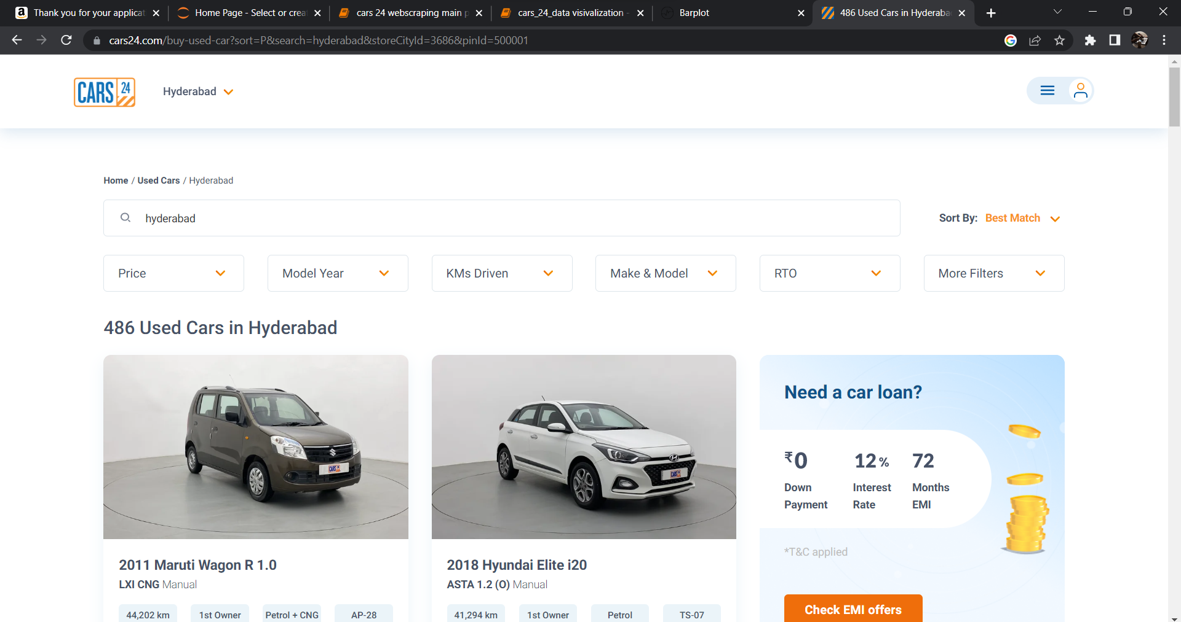
CARS24 Main Webpage to be extracted

Slide 8
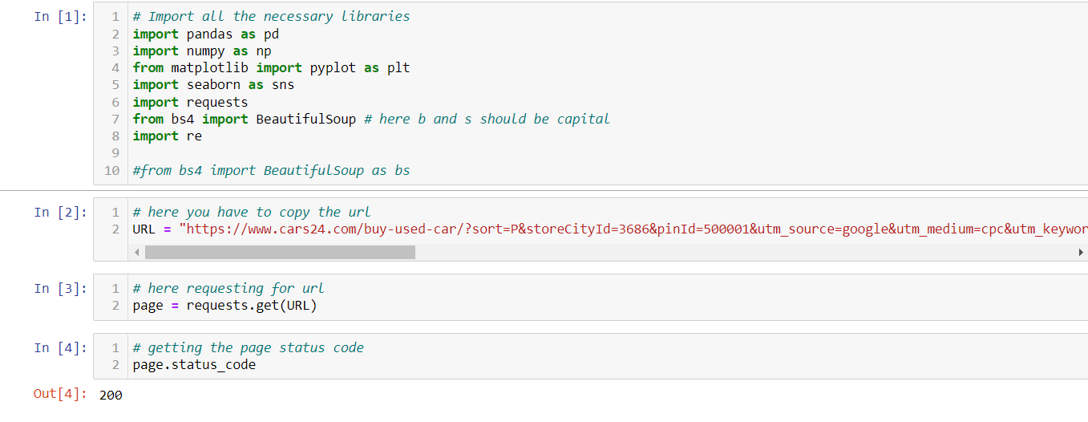
Importing all the libraries :
I have check for the status code and it displays 200 means we can scrape the data for educational purpose

Slide 9
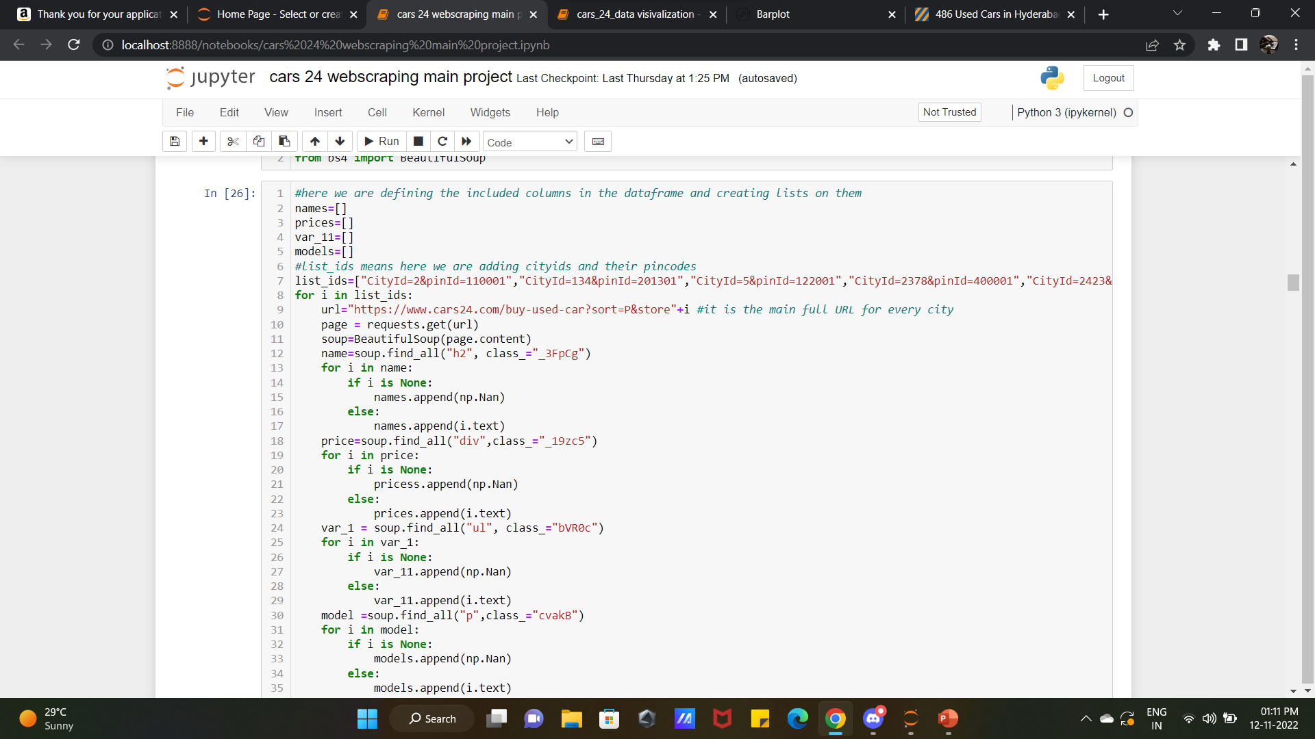

Slide 10
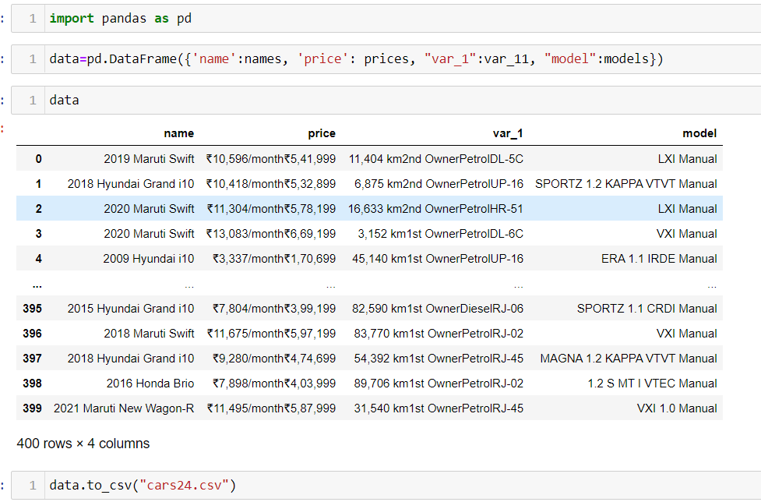
In the above code I have declared 20 cities code and extracted all that data and check all the column length data ,they are equal and I have created a Data Frame and I convert that to a csv format for further process.

Slide 11


Slide 12
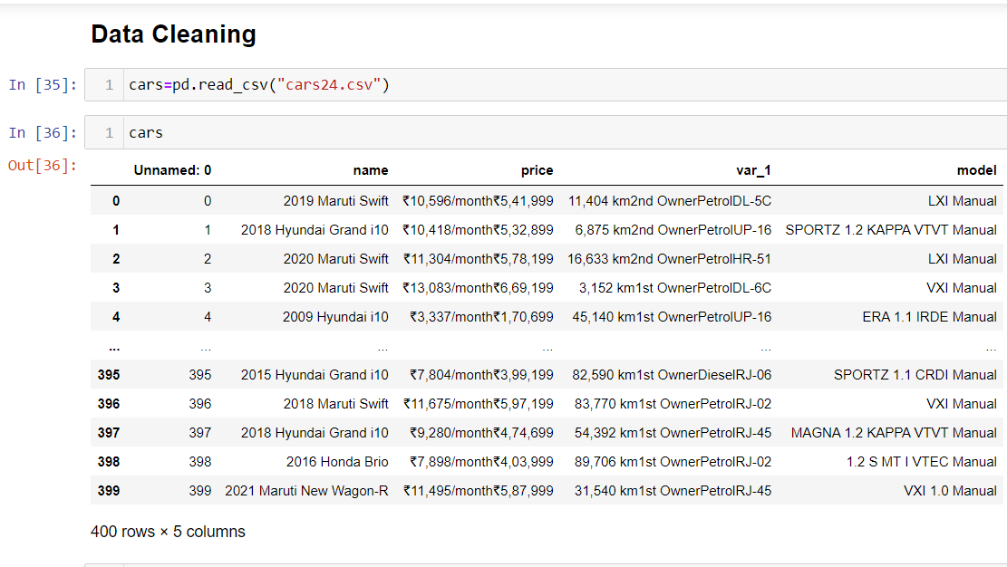
Before cleaning data the data frame looks like:

Slide 13
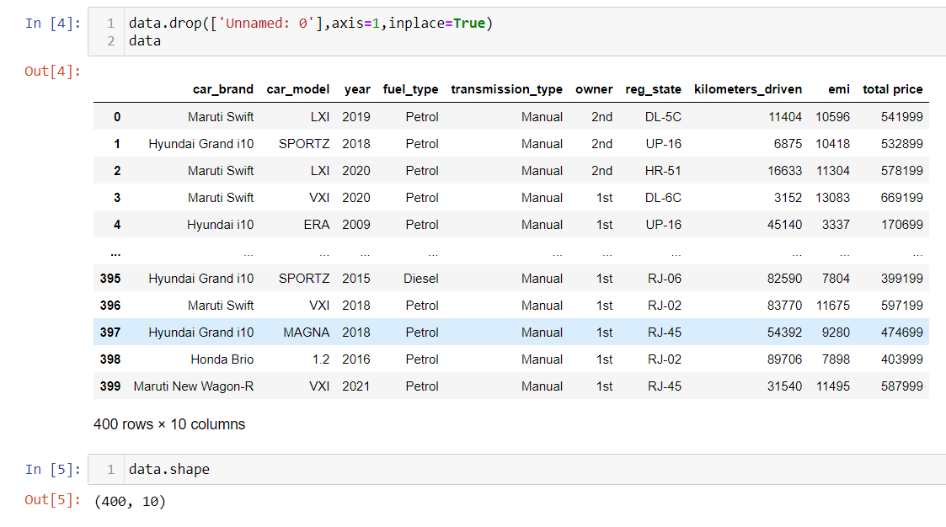
After cleaning the data the data frame looks like:

Slide 14
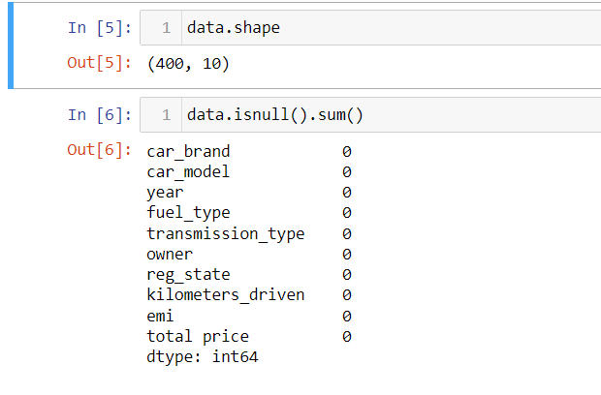
After that I have checked for the null values and there are totally zero
So up to here I have done with data cleaning process and we are good to go for data visualization because I have get the necessary columns and the data is perfectly good for Visualiation

Slide 15


Slide 16
As I already said that the main aim of the project is the price analysis of a used car and I taken four factors for this
transmission type
Kilometres driven
Fuel type
Year

Slide 17
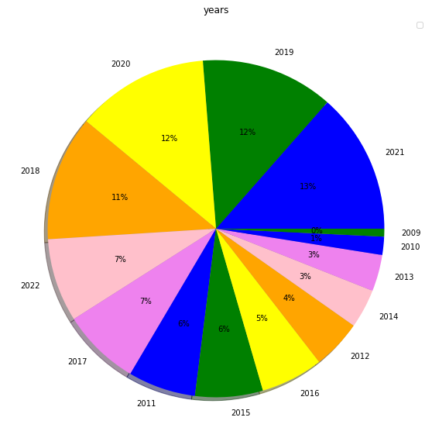
Univariant analysis
Availability of cars based on year
In this pie chart more no of cars are been saled in the year 2020 2019, 2021

Slide 18
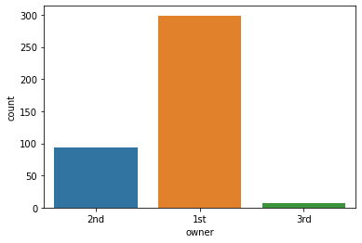
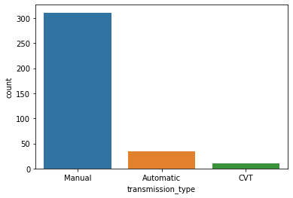
Univariant analysis
In the above count plot we can see that 1st owners are more to sell their cars =274
In the above count plot we can see that manual is more in number when compared to other transmission types Manual=311

Slide 19
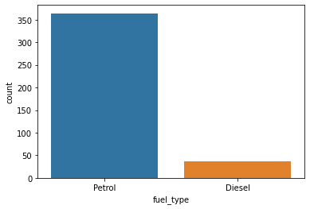
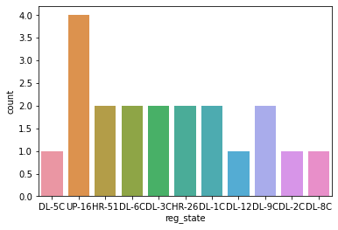
Univariant analysis
In the above count plot up-16 is the state having highest no of cars to be selled
By their owners
In the above count plot petrol is the most used fuel type when compared to diesel petrol==324

Slide 20
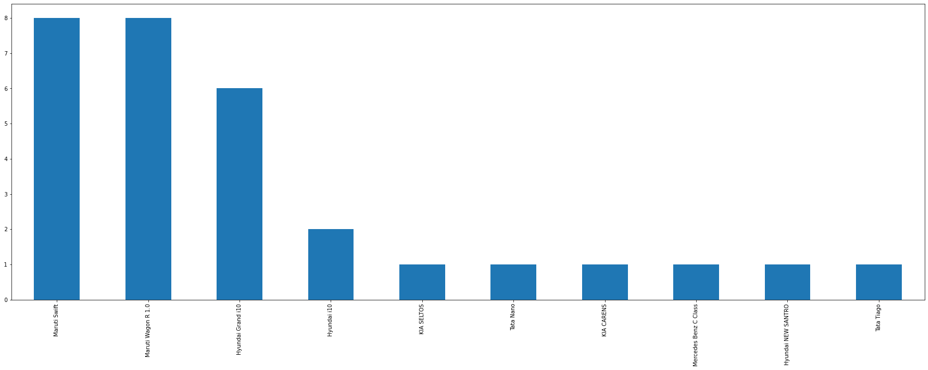
Univariant analysis
From my dataset I can say that Maruti swift are the cars more in number and there are total 59

Slide 21
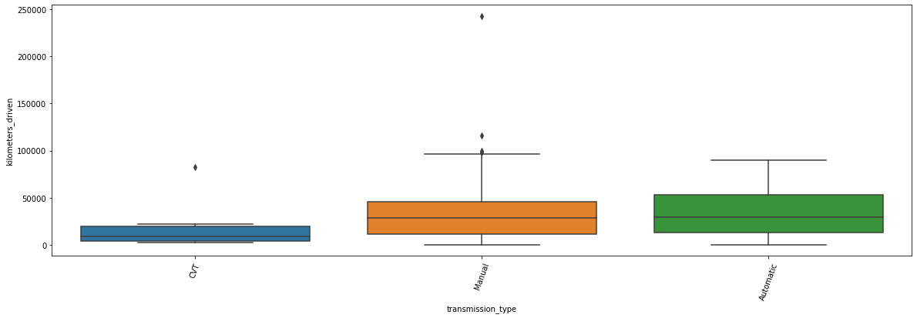
Bivariant analysis
From the above box plot we can observe that in manual type only one car has travelled more than any other car =250000KMS the least travelled by the manual is approx 5000kMS and for same to automatic

Slide 22
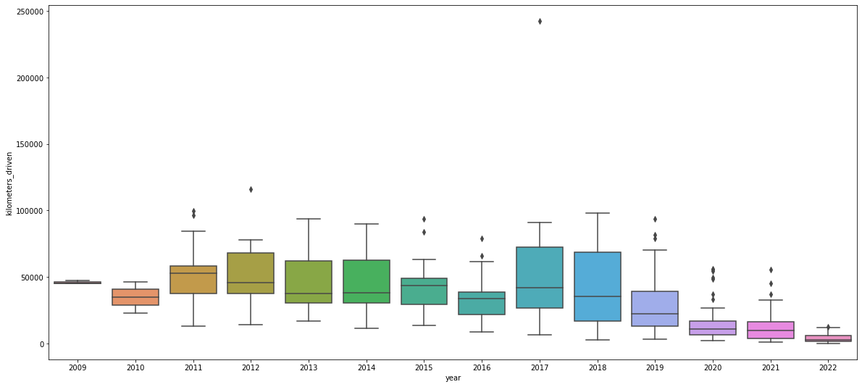
In the year 2017 there is a cars which is more driven kms=242614(highest) and the car name is Maruti ERTIGA

Slide 23
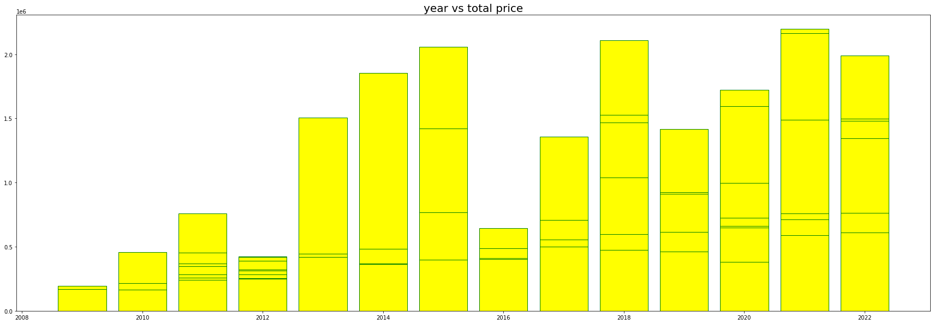
From the above bar plot we can conclude that there is a car in the year 2021 which is been seld at high cost almost 219779 ( Hyundai ALCAZAR)

Slide 24
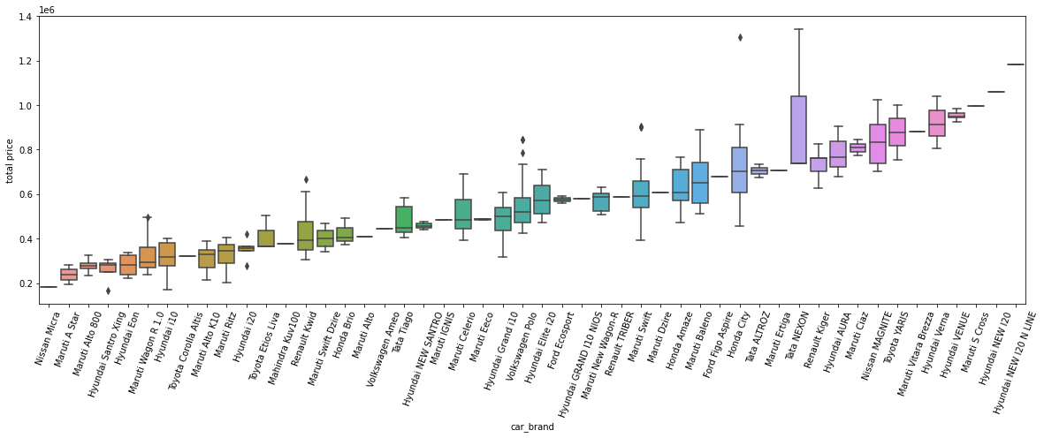
From the above box plot Nissan micra is the only car having lowest price and there is one customer who had buied a car (Honda city) for higher rate

Slide 25
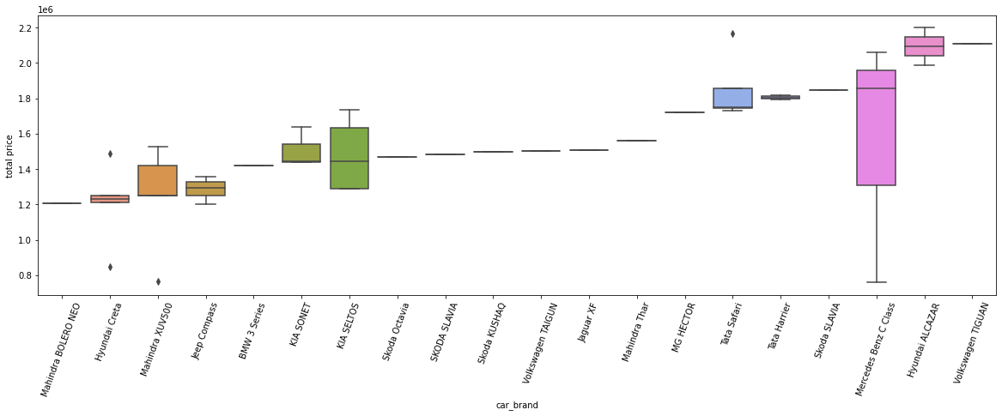
From the above box plot tata safari is the car where a customer had paid more price and Mahindra XUV is the car which have been sold for very least rate

Slide 26
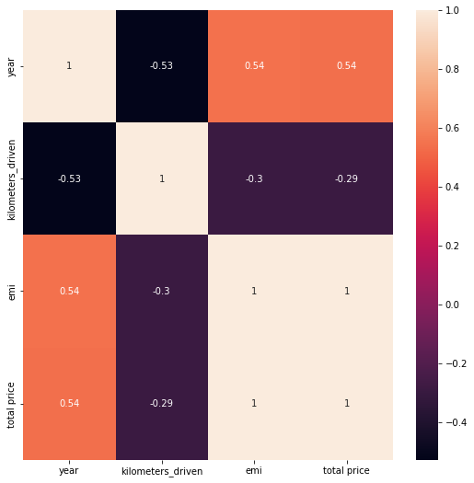
Multi variant analysis
In the heat map we can observe that as year increases the total price and the Emi are going to be decrease
And the year and kilometres driven they are directly proportional to each other means as one parameter increases the other also increases

Slide 27
Conclusion
USED CARS From the year 2010 ---2016 :
we can say that the selling of 1st hand cars is not more when compare to the years 2019—2021
There are various reasons for that from my intuitions one of the main reason would be the pandemic situation most of them are used to sell their properties to higher/lower rates for their needs
From the above conclusions I can say that the total price of the car decreases when the car travelled more no of kilometres

Slide 28


Slide 29

THANK YOU

